Slide 1

Transfer Learning Based Kidney Stone Detection Using ResNet50
by
P.Roshni
Roll No. 204G1A0583
T.M.Sai Pavan
Roll No. 204G1A0589
P.Sowmitha
Roll No. 204G1A05C8
G. Naga Siva Rama Krishna
Roll No 214G5A0509.
Under the guidance of
Mr. C. Nagesh M.Tech(Ph.D)
Assistant Professor
Department of Computer Science and Engineering
Srinivasa Ramanujan Institute of Technology
(Autonomous)
2023 - 2024

Slide 2

Contents
Abstract
Problem statement
Objectives of Project
Literature survey for first objective
Literature survey for second objective
Proposed Work -(Methods to be followed for proposed system)
References
GitHub Link
Queries

Slide 3
Abstract
The kidneys play a crucial role in human health by filtering the blood and maintaining normal amounts of Sodium, Potassium. Kidney stone detection is a critical medical challenge necessitating accurate diagnosis for timely intervention. Traditional diagnostic methods often involve manual examination of medical images by healthcare professionals, which can be time-consuming and subject to human error.
An automated detection of kidney stone (having stone/not) using coronal computed tomography (CT) images is proposed with deep learning (DL) technique which has recently made significant progress in the field of artificial intelligence. In this study, we addressed the task of kidney stone detection through transfer learning(TL) with ResNet50 using medical images.The model demonstrated to address limited medical data challenges, superior accuracy and sensitivity in detecting kidney stones compared to traditional methods. Moreover, it exhibited a robust ability to generalize, even in the presence of variations and noise in medical images.
KeyWords: Kidney Stone,ResNet50,Deep Learning,Transfer Learning.

Slide 4
Problem Statement
Millions of urolithiasis cases are occurring worldwide.
Late kidney stone detection can have serious consequences for an individual's health, including prolonged pain, kidney damage, infections, and complications.
To target low-latency applications in medical imaging, we are developing a real-time kidney stone detection system using ResNet50.This optimizes the model's architecture and implement efficient inference techniques to ensure timely and accurate detection of kidney stones.

Slide 5
Objectives of Project
To Design a transfer learning framework that handles class imbalance effectively that ensures accurate detection of multiple stone in kidney.
To Explore techniques for tuning the layers in the learning model that improve the model's robustness and adaptability.

Slide 6
Literature survey for first objective
Soni et al. 2020[1] proposed automated kidney Stone Classification using machine learning. Histogram Equalization is advantageous for improving image contrast thereby enhancing data quality.This method involves adjusting the distribution of pixel intensity to achieve uniformity throughout the image.This process aided in extracting more detailed information from images that had low contrast or poor lighting. Ultimately, this significantly contributed to enhancing the accuracy of determining the presence or absence of urinary tract stones. This proposed ML approach achieved an accuracy of 95.8% in the CT image database.

Slide 7
Literature survey for second objective
Viswanath et al. 2015[2] proposed a level set segmentation-based kidney stone detection and classification method. Compared to other imaging systems, ultrasound images are easily vulnerable to speckle noises. Initially, the images are preprocessed using a Gabor filter for noise removal. To get a stone portion, level set segmentation is applied. Finally, a feed-forward neural network model is applied to classify the stone levels.
The selection and tuning of layers in TL are complex issues. the accuracy of TL is depending on layerperformance. These issues are considered and solved by Vrbancic et al. 2020 [3]. the Differential Evolution based Fine-Tuning (DEFT) techniques are proposed to tune the layers in the learning model in order toincrease efficiency.

Slide 8
Proposed System
To overcome the difficulty of the existing system, We will develop a framework using deep learning that aims to diagnose the kidney stones using images . ResNet50 increases the feature extraction capability enhancing the accuracy and efficiency. TL is knowledge transfer from one block to another block in order to improve the efficiency of the learning model.
Proposed system will use CycleGAN for Data augmentation and k-fold cross-validation techniques to assess the performance of the developed models.

Slide 9
References
[1].A. Soni and A. Rai, “Kidney Stone Recognition and Extraction using Directional Emboss & SVM from Computed Tomography Images” in 2020 Third Int. Conf. on Multimedia Processing, Communication & InformationTechnology (MPCIT), Shivamogga, India, pp. 172–183, 2020.
[2]. K. Viswanath and R. Gunasundari, "Analysis and Implementation of Kidney Stone Detection by Reaction Diffusion Level Set Segmentation Using Xilinx System Generator on FPGA", VLSI Design, vol. 2015, Article 581961, 10 pages, 2015.
[3].G. Vrbancic and V. Podgorelec, “Transfer learning with adaptive fine-tuning,” IEEE Access, vol. 8, no. 4, pp.196197–196211, 2020.

Slide 10
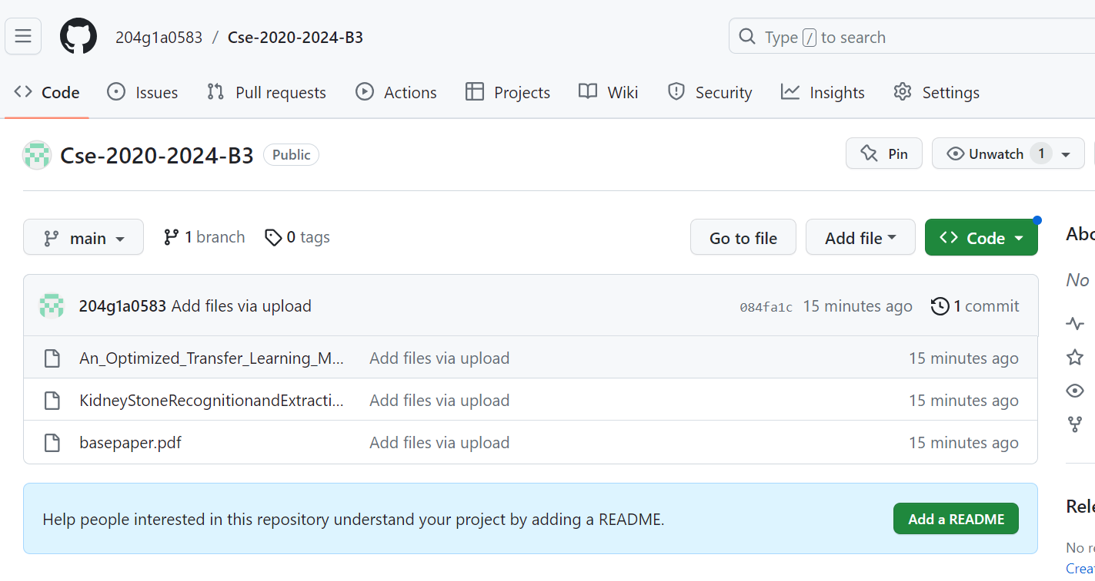
Git Hub Dashboards of each student
https://github.com/204g1a0583/Cse-2020-2024-B3

Slide 11
Any Queries?

